Slide 1
Foundations of Cryptography plain RSA, RSA-OAEP, digital signature
LiangFeng Zhang
zhanglf@shanghaitech.edu.cn
SIST, ShanghaiTech, 2019F

Slide 2
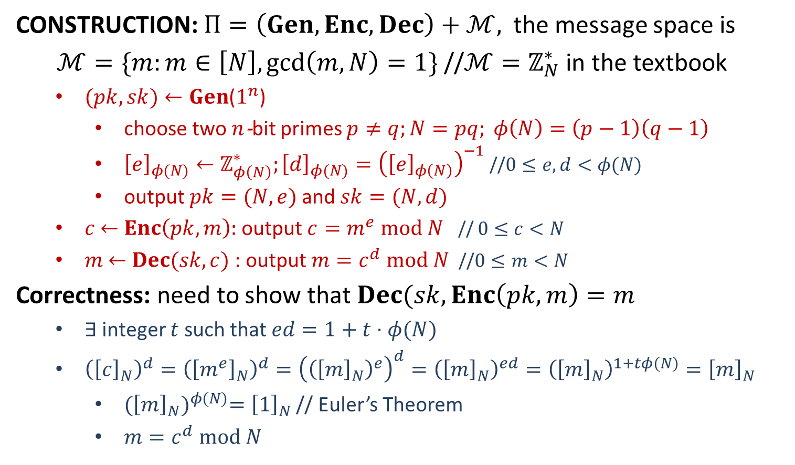
Plain RSA
CONSTRUCTION: $Π=\left(Gen,Enc,Dec\right)+ℳ,$the message space is
$ℳ=\{m:m∈\left[N\right],\gcd\left(m,N\right)=1\}$ //$ℳ=ℤ_{N}^{∗}$ in the textbook
$(pk, sk)←Gen$($1^{n}$)
choose two $n$-bit primes $p≠q;N=pq; φ\left(N\right)=\left(p−1\right)\left(q−1\right)$
${\left[e\right]}_{φ(N)}←ℤ_{φ\left(N\right)}^{∗};{\left[d\right]}_{φ(N)}={\left({\left[e\right]}_{φ\left(N\right)}\right)}^{−1}$//$0≤e, d<φ(N)$
output $pk=(N, e)$and $sk=(N, d)$
$c$ $←$ $Enc\left(pk, m\right):$ output $c=m^{e} mod N$ // $0≤c<N$
$m$ $←$ $Dec(sk, c)$ : output $m=c^{d} mod N$ //$0≤m<N$
Correctness: need to show that $Dec(sk, Enc\left(pk,m\right)=m$
$∃$ integer $t$ such that $ed=1+t⋅φ(N)$
${\left({\left[c\right]}_{N}\right)}^{d}={\left({\left[m^{e}\right]}_{N}\right)}^{d}={\left({\left({\left[m\right]}_{N}\right)}^{e}\right)}^{d}={\left({\left[m\right]}_{N}\right)}^{ed}={\left({\left[m\right]}_{N}\right)}^{1+tφ(N)}={\left[m\right]}_{N}$
${({\left[m\right]}_{N})}^{φ(N)}={\left[1\right]}_{N}$ // Euler’s Theorem
$m=c^{d} mod N$

Slide 3
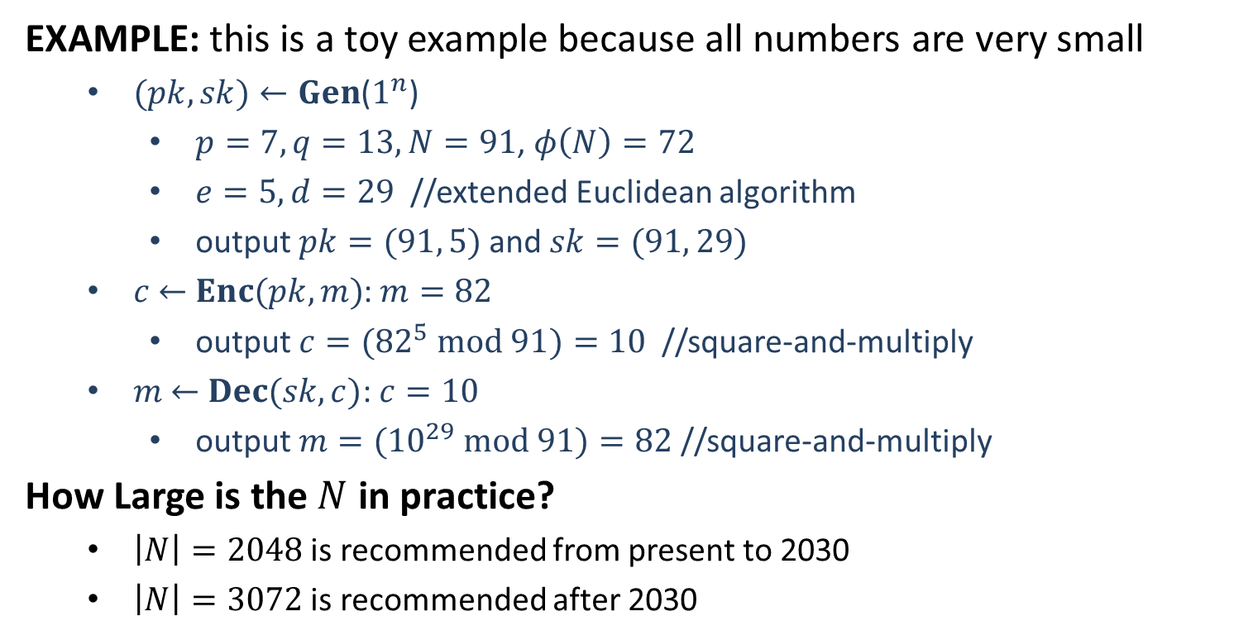
Plain RSA
EXAMPLE: this is a toy example because all numbers are very small
$(pk, sk)←Gen$($1^{n}$)
$p=7, q=13,N=91$, $φ\left(N\right)=72$
$e=5, d=29$ //extended Euclidean algorithm
output $pk=(91, 5)$and $sk=(91, 29)$
$c$ $←$ $Enc(pk, m)$: $m=82$
output $c=({82}^{5} mod 91)=10$ //square-and-multiply
$m$ $←$ $Dec(sk, c)$: $c=10$
output $m=({10}^{29} mod 91)=82$ //square-and-multiply
How Large is the $N$ in practice?
$\left|N\right|=2048$ is recommended from present to 2030
$\left|N\right|=3072$ is recommended after 2030

Slide 4
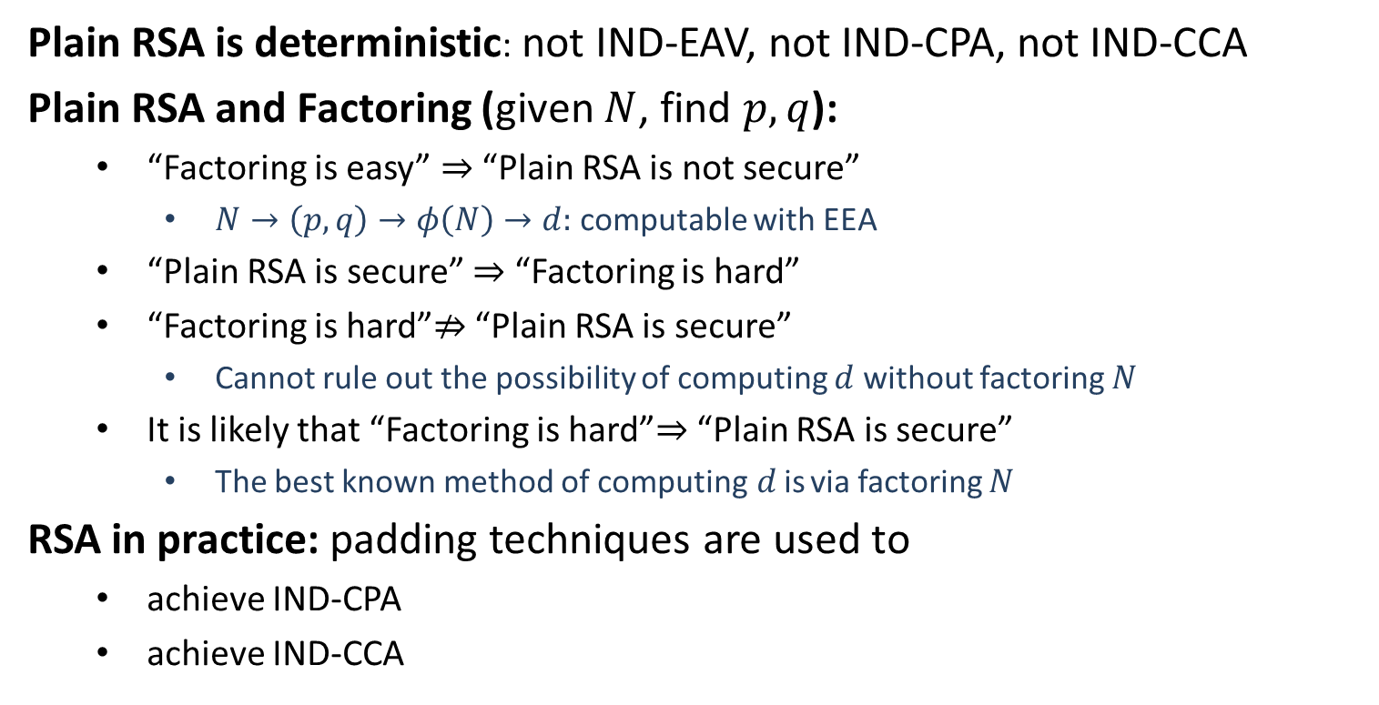
Security
Plain RSA is deterministic: not IND-EAV, not IND-CPA, not IND-CCA
Plain RSA and Factoring (given $N$, find $p,q$):
“Factoring is easy” $⇒$ “Plain RSA is not secure”
$N→\left(p,q\right)→φ\left(N\right)→d:$ computable with EEA
“Plain RSA is secure” $⇒$ “Factoring is hard”
“Factoring is hard”$⇏$ “Plain RSA is secure”
Cannot rule out the possibility of computing $d$ without factoring $N$
It is likely that “Factoring is hard”$⇒$ “Plain RSA is secure”
The best known method of computing$d$is via factoring $N$
RSA in practice: padding techniques are used to
achieve IND-CPA
achieve IND-CCA

Slide 5


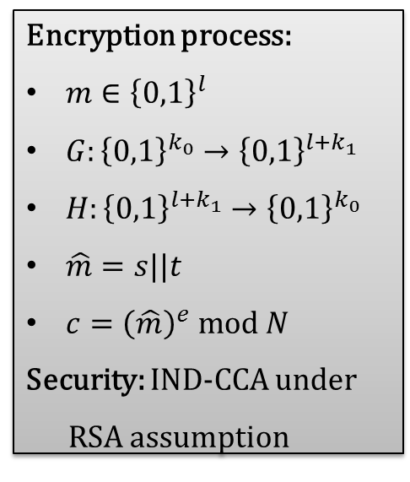
RSA-OAEP
RSA Optimal Asymmetric Encryption Padding: Variant of padded RSA,
part of the RSA PKCS #1 since version 2.0
Encryption process:
$m∈{\left\{0,1\right\}}^{l}$
$G:{\left\{0,1\right\}}^{k_{0}}→{\left\{0,1\right\}}^{l+k_{1}}$
$H:{\left\{0,1\right\}}^{l+k_{1}}→{\left\{0,1\right\}}^{k_{0}}$
$\hat{m}=s||t$
$c={\left(\hat{m}\right)}^{e} mod N$
Security: IND-CCA under
RSA assumption
$l+k_{1}$ bits
$k_{0}$ bits
RSA Assumption: Given $N,e$ and $y←ℤ_{N}^{∗}$, it is hard to learn $x∈ℤ_{N}^{∗}$ such that $x^{e}=y$.

Slide 6
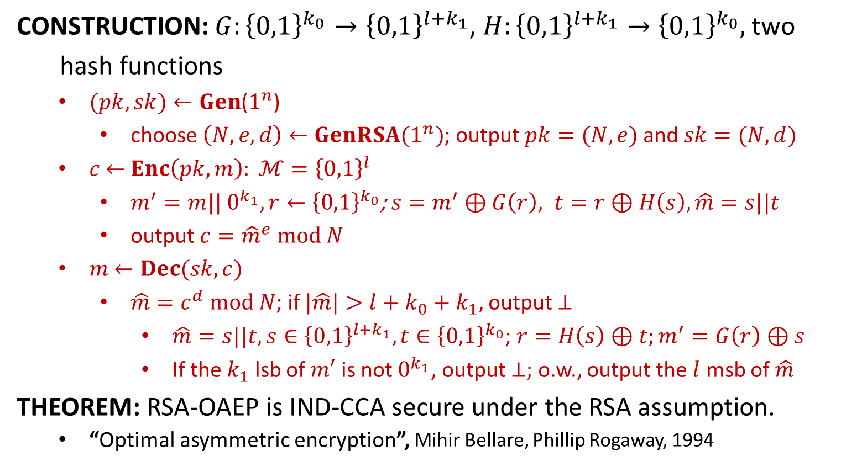
RSA-OAEP
CONSTRUCTION: $G:{\left\{0,1\right\}}^{k_{0}}→{\left\{0,1\right\}}^{l+k_{1}}$, $H:{\left\{0,1\right\}}^{l+k_{1}}→{\left\{0,1\right\}}^{k_{0}},$two
hash functions
$(pk, sk)←Gen$($1^{n}$)
choose $\left(N,e,d\right)←GenRSA(1^{n})$; output $pk=(N, e)$and $sk=(N, d)$
$c$ $←$ $Enc\left(pk, m\right): ℳ={\left\{0,1\right\}}^{l}$
$m^{′}=m|| 0^{k_{1}}, r←{\left\{0,1\right\}}^{k_{0}}$; $s=m^{′}⊕G\left(r\right), t=r⊕H\left(s\right), \hat{m}=s||t$
output $c={\hat{m}}^{e} mod N$
$m$ $←Dec(sk, c)$
$\hat{m}=c^{d} mod N$; if $|\hat{m}|>l+k_{0}+k_{1},$output $⊥$
$\hat{m}=s||t, s∈{\left\{0,1\right\}}^{l+k_{1}}, t∈{\left\{0,1\right\}}^{k_{0}}$; $r=H\left(s\right)⊕t;m^{′}=G\left(r\right)⊕s$
If the $k_{1}$ lsb of $m′$ is not $0^{k_{1}}$, output $⊥;$ o.w., output the $l$ msb of $\hat{m}$
THEOREM: RSA-OAEP is IND-CCA secure under the RSA assumption.
“Optimal asymmetric encryption”, Mihir Bellare, Phillip Rogaway, 1994

Slide 8


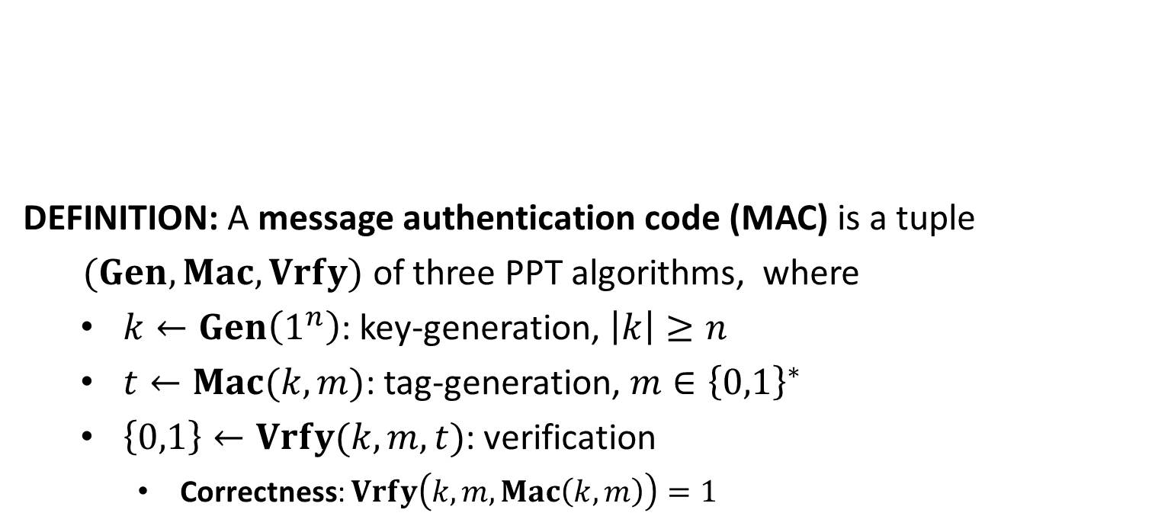




Message Authentication Code
DEFINITION: A message authentication code (MAC) is a tuple
$(Gen, Mac,Vrfy)$ of three PPT algorithms, where
$k←Gen\left(1^{n}\right)$: key-generation, $\left|k\right|≥n$
$t←Mac(k,m)$: tag-generation, $m∈{\left\{0,1\right\}}^{∗}$
$\left\{0,1\right\}←Vrfy(k,m,t)$: verification
Correctness: $Vrfy\left(k,m,Mac\left(k,m\right)\right)=1$
message $m$
tag $t$
$$k$$
$$k$$

Slide 9

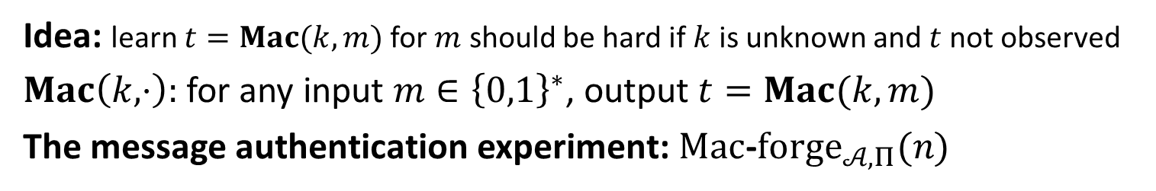

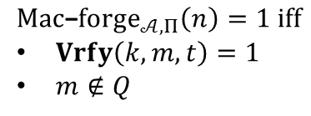





Security
Idea: learn $t=Mac(k,m)$ for $m$ should be hard if $k$ is unknown and $t$ not observed
$Mac\left(k,⋅\right):$ for any input $m∈{\left\{0,1\right\}}^{∗}$, output $t=Mac(k,m)$
The message authentication experiment: $Mac$-$forge_{𝒜,Π}(n)$
$$k←Gen\left(1^{n}\right)$$
$$oracle access to$$
$$Mac(k,⋅)$$
$$Challenger$$
$$Adversary 𝒜$$
$$(m,t)$$
$$Mac\text{−}forge_{𝒜,Π}\left(n\right)=1 iff$$
$Vrfy\left(k,m,t\right)=1$
$m∉Q$
$Q:$ the set of messages queried by $𝒜$

Slide 10
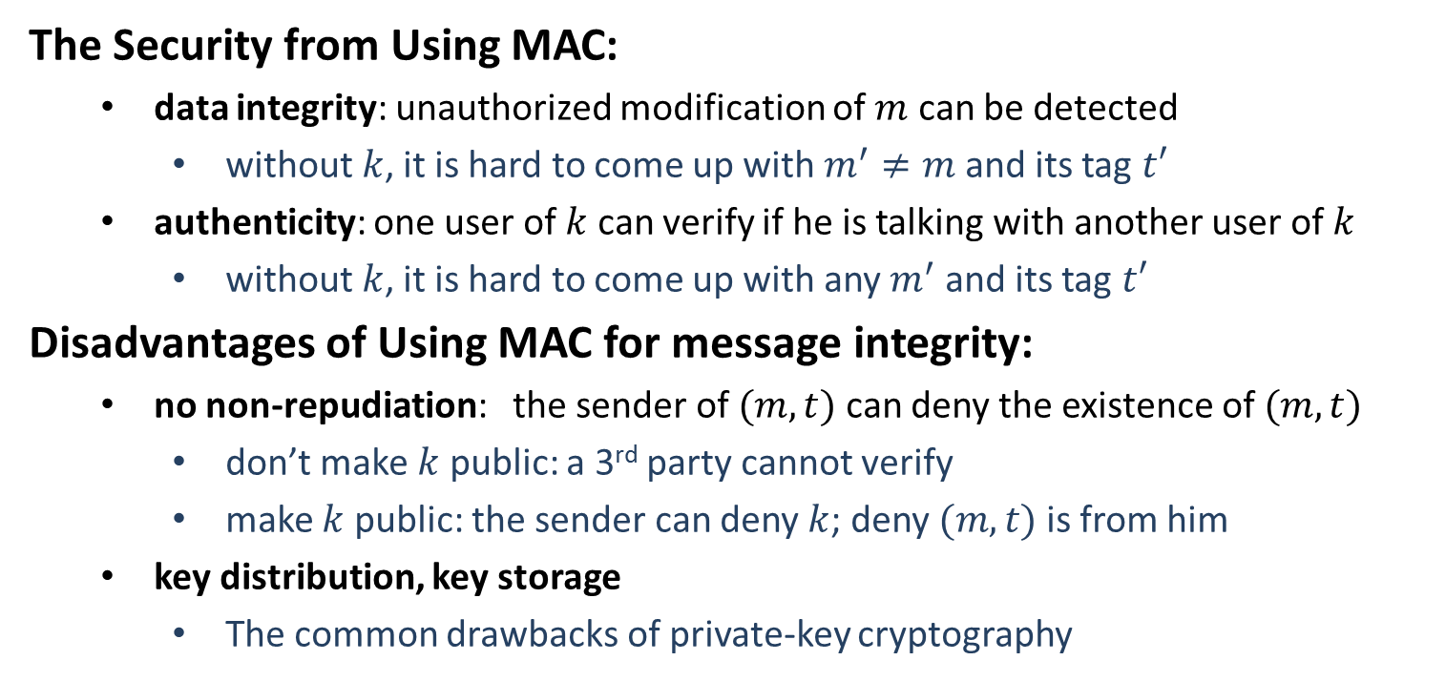
Security
The Security from Using MAC:
data integrity: unauthorized modification of $m$ can be detected
without$k$, it is hard to come up with $m^{′}≠m$ and its tag $t′$
authenticity: one user of $k$ can verify if he is talking with another user of $k$
without$k$, it is hard to come up with any $m^{′}$ and its tag $t′$
Disadvantages of Using MAC for message integrity:
no non-repudiation: the sender of $(m,t)$ can deny the existence of $(m,t)$
don’t make $k$ public: a 3rd party cannot verify
make $k$ public: the sender can deny $k$; deny $(m,t)$ is from him
key distribution, key storage
The common drawbacks of private-key cryptography

Slide 11

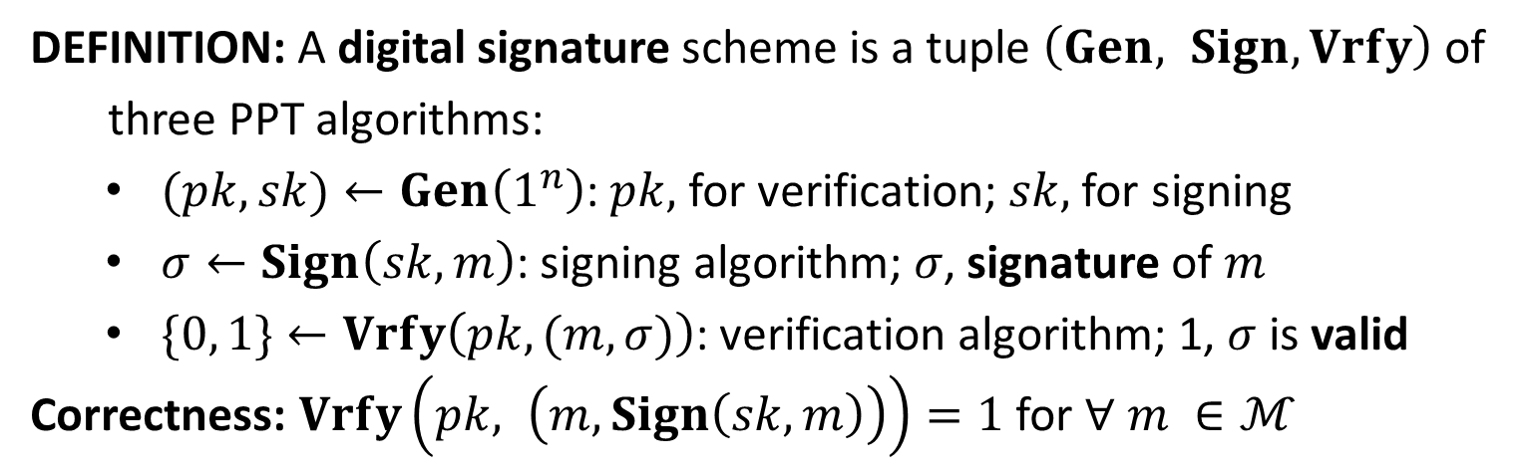


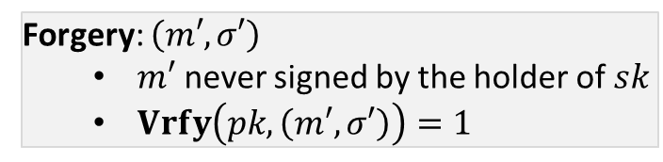


Digital Signature
DEFINITION: A digital signature scheme is a tuple $\left(Gen, Sign, Vrfy\right)$ of
three PPT algorithms:
$(pk,sk)←Gen\left(1^{n}\right)$: $pk,$ for verification; $sk,$ for signing
$σ←Sign\left(sk, m\right)$: signing algorithm; $σ$, signature of $m$
$\{0, 1\}←Vrfy\left(pk, (m,σ)\right)$: verification algorithm; 1, $σ$ is valid
Correctness: $Vrfy\left(pk, \left(m, Sign\left(sk,m\right)\right)\right)=1$ for $∀ m ∈ℳ$
$$(m, σ)$$
$$(m′, σ′)$$
$$?Vrfy\left(pk, \left(m, σ\right)\right)=1$$
Alice
Bob
Forgery: $\left(m′, σ′\right)$
$m′$ never signed by the holder of $sk$
$Vrfy\left(pk, \left(m′, σ′\right)\right)=1$
$$sk$$
A
$$pk$$

Slide 12








Security
The Signature Experiment $Sig−forge_{𝒜,Π}(n)$
$$(pk,sk)←Gen\left(1^{n}\right)$$
$$pk$$
$$orace access to$$
$$Challenger$$
$$Sign(sk,⋅)$$
$$Adversary 𝒜$$
$$(m,σ)$$
$$output 1 if and only if$$
$m never signed with sk$
$Vrfy\left(pk,\left(m,σ\right)\right)=1$

Slide 13
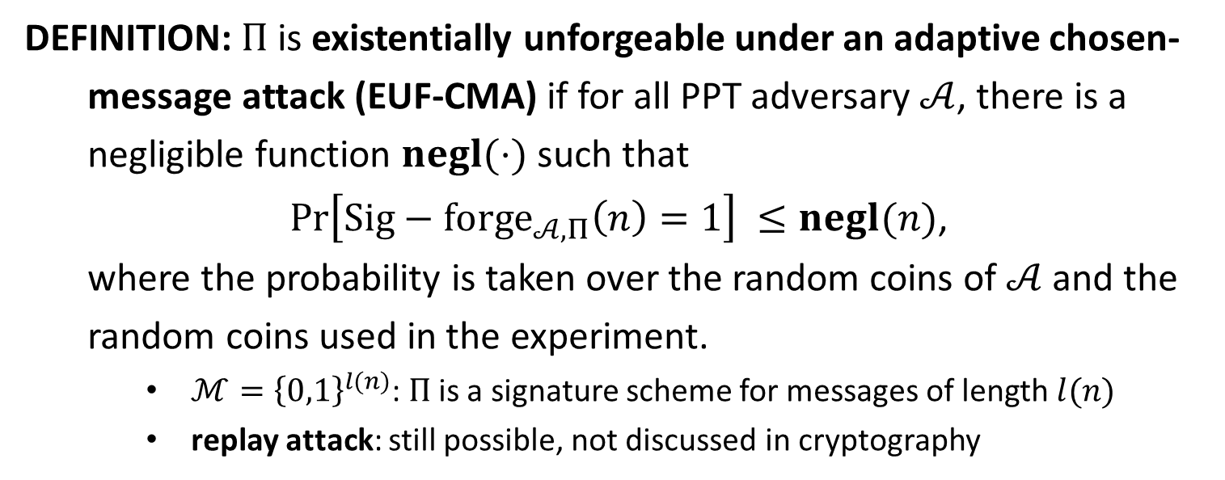
EUF-CMA
DEFINITION: $Π$is existentially unforgeable under an adaptive chosen-
message attack (EUF-CMA) if for all PPT adversary $𝒜$, there is a
negligible function $negl(⋅)$ such that
$\operatorname{Pr}\left[Sig−forge_{𝒜,Π}\left(n\right)=1\right] ≤negl(n)$,
where the probability is taken over the random coins of $𝒜$ and the
random coins used in the experiment.
$ℳ={\left\{0,1\right\}}^{l(n)}$: $Π$ is a signature scheme for messages of length $l(n)$
replay attack: still possible, not discussed in cryptography

Slide 14
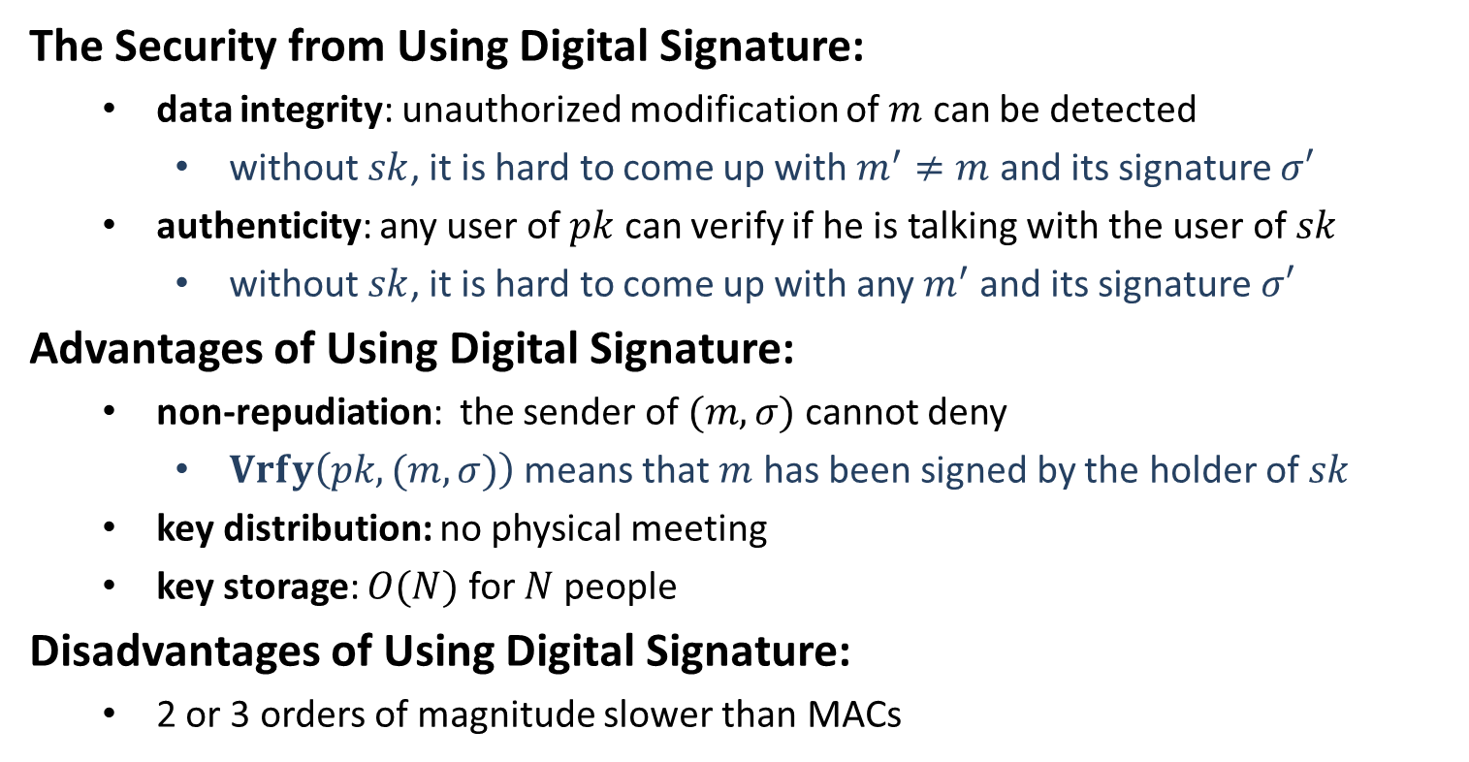
Security
The Security from Using Digital Signature:
data integrity: unauthorized modification of $m$ can be detected
without$sk$, it is hard to come up with $m^{′}≠m$ and its signature $σ′$
authenticity: any user of $pk$ can verify if he is talking with the user of $sk$
without$sk$, it is hard to come up with any $m^{′}$ and its signature $σ′$
Advantages of Using Digital Signature:
non-repudiation: the sender of $(m,σ)$ cannot deny
$Vrfy\left(pk, (m,σ)\right)$ means that $m$ has been signed by the holder of $sk$
key distribution: no physical meeting
key storage: $O(N)$ for $N$ people
Disadvantages of Using Digital Signature:
2 or 3 orders of magnitude slower than MACs

